Slide 1
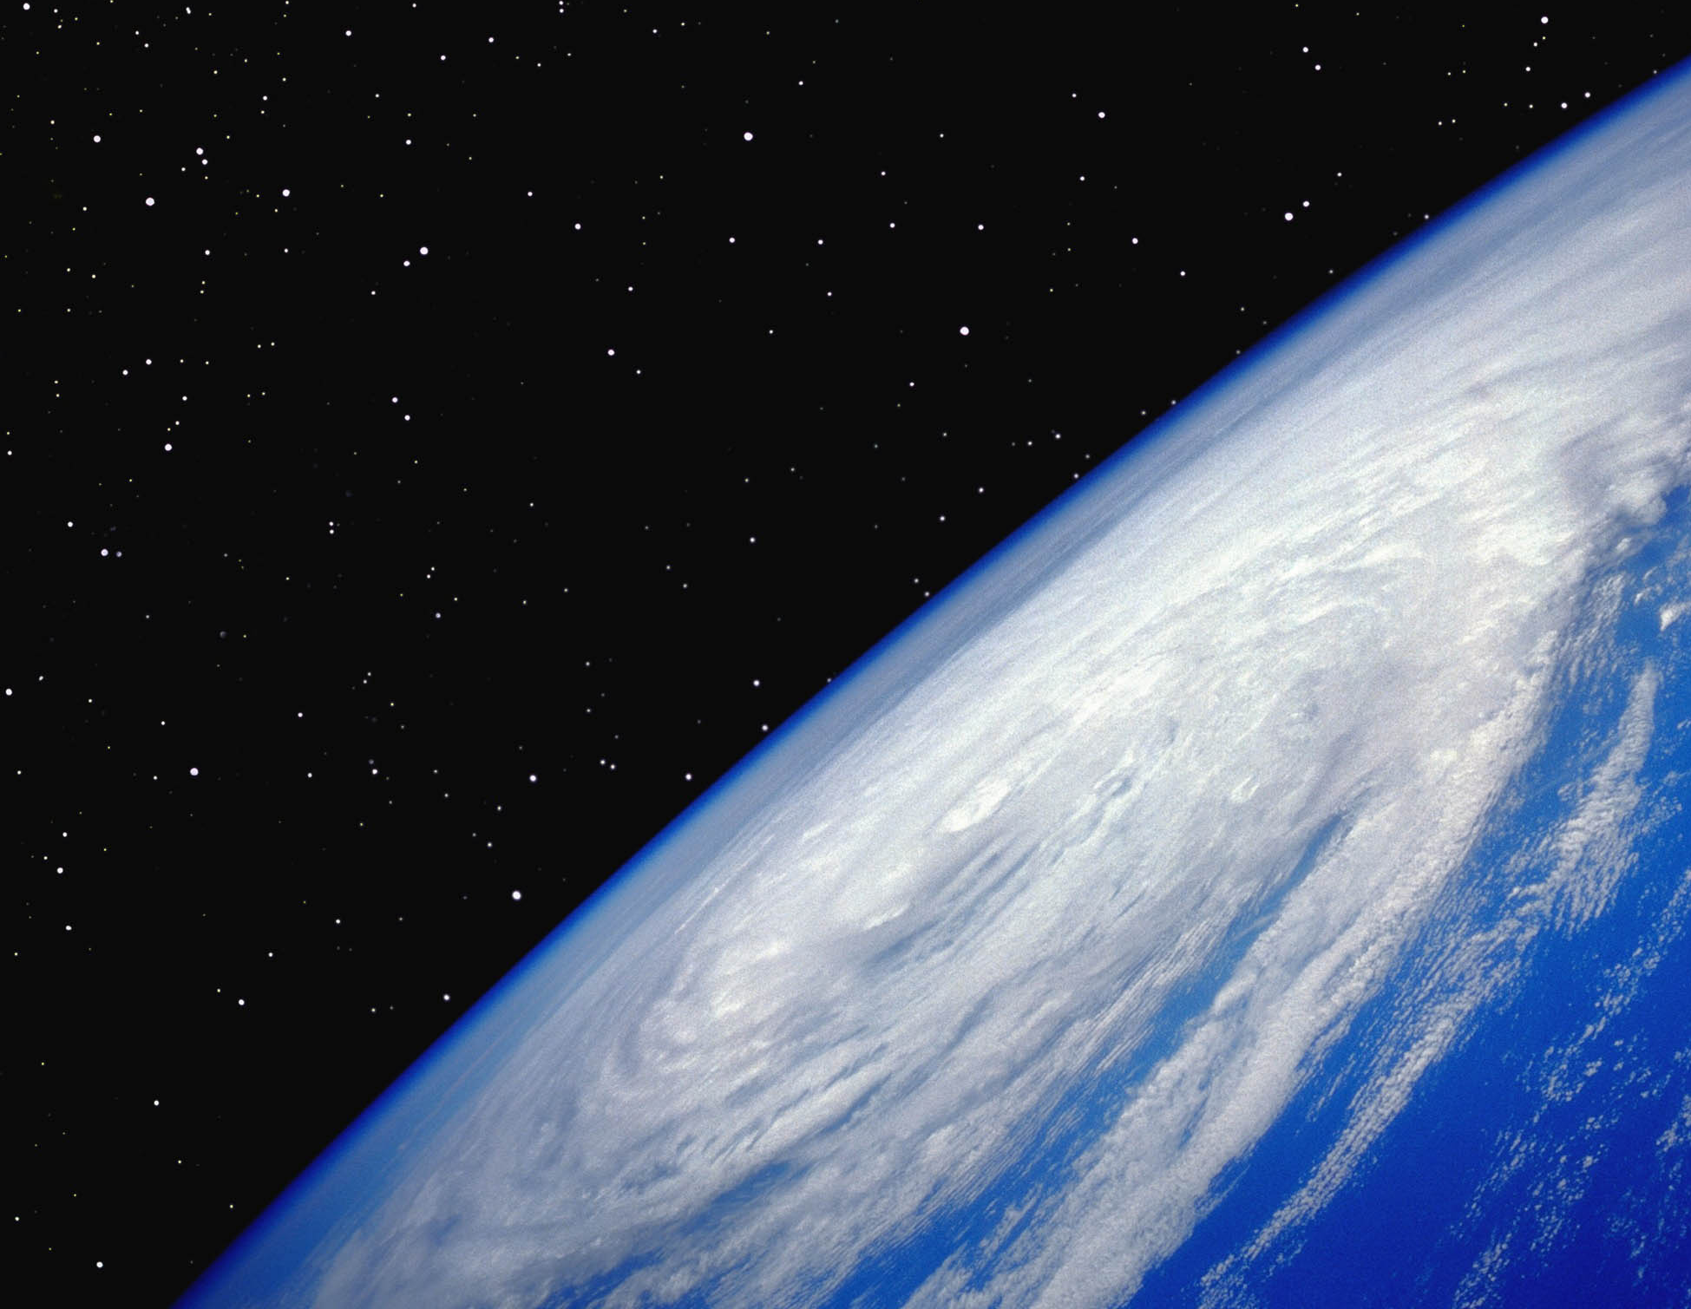
Understanding the Science of Climate Change
Susquehanna University
January 9, 2015
http://wallpapersus.com/hurricane-from-space/

Slide 2
Key Concepts
Energy Balance → Energy In versus Energy Out
Greenhouse Gases → Affect Balance
Evidence of Energy Imbalance
Ocean
Atmosphere
Land and Sea Ice
Sea Level

Slide 3
How Does Earth Gain and Lose Heat?
Earth exists in near-perfect vacuum, a near-perfect insulator
Energy is gained and lost ONLY by radiation
Earth gains energy by absorption of radiation from the sun
Earth releases energy by emission of thermal radiation from Earth

Slide 4
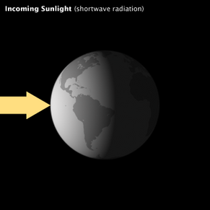
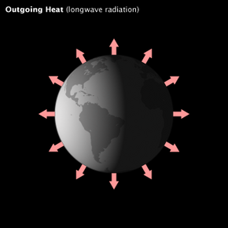
Top of Atmosphere (TOA) Energy Balance
Solar Irradiation (short wave)
Earth Thermal Radiation (long wave)
TSI
OLR
http://www.eoearth.org/article/Energy_balance_of_Earth

Slide 5
Comparison of TSI and OLR
Outgoing Longwave Radiation (OLR) from Earth
(Increases as temperature of Earth increases)
Total Solar Irradiance (TSI) from Sun
Intensity
Wavelength, micrometers
http://www.eoearth.org/article/Energy_balance_of_Earth

Slide 6
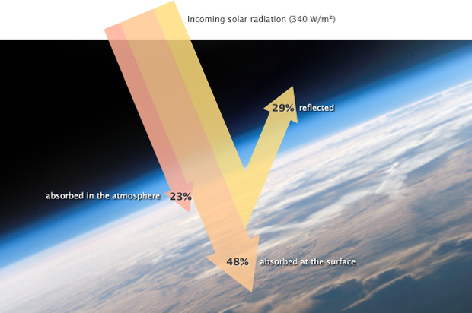
Fates of TSI
Reflected (Albedo): Ice, Snow, Desert Sand, Clouds, Aerosols
Absorbed in Atmosphere: Water vapor, Ozone, Dust, Clouds
Absorbed at Surface: Oceans, Forests, Fields, etc.
http://www.eoearth.org/article/Energy_balance_of_Earth

Slide 7
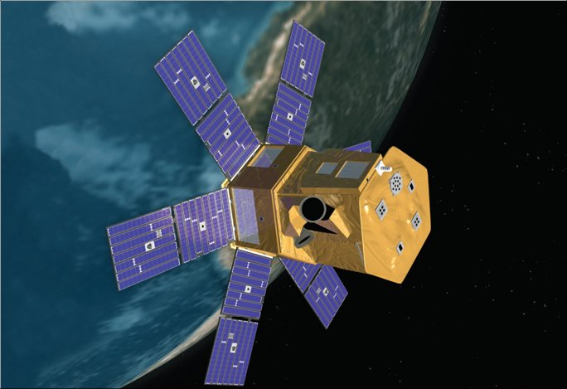
Top of Atmosphere (TOA) Satellites Measure TSI and OLR
1. NASA’s Solar Radiation and Climate Experiment (SORCE) Measures TSI
2. NASA CERES Project Measures OLR and Reflected TSI from Earth
http://en.wikipedia.org/wiki/File:Nimbus_rendering.jpg

Slide 8
SORCE TSI Measurements
Decade | Ave. TSI, W/m²
1981-1990 | 1361.3
1991-2000 | 1361.2
2000-2010 | 1361.2
http://lasp.colorado.edu/sorce/data/tsi_data.htm

Slide 9
Greenhouse Gases (GHG)
Earth Thermal Radiation
Certain trace gases in atmosphere, water vapor, and clouds can absorb OLR and reduce the amount of heat leaving Earth
Key GHG are CO₂, CH₄, O₃, and N₂O

Slide 10
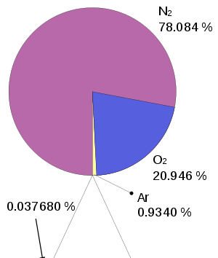
Composition of Atmosphere (Dry) on Earth
99.96% of dry atmosphere is transparent to OLR
Greenhouse Gases: CO₂ (0.0395%), CH₄ (.00018%), O₃ (<0.00001%), and Water (0.4 %)

Slide 11
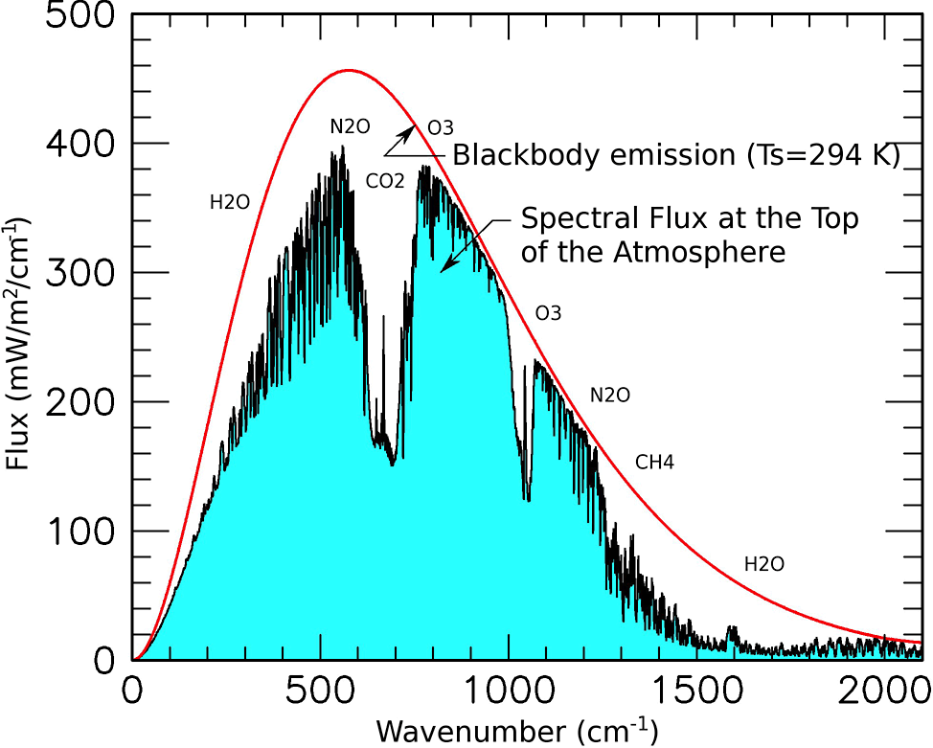
Effect of GHG on Cooling by OLR
No GHG in Atmosphere
GHG Present in Atmosphere
www.giss.nasa.gov

Slide 12
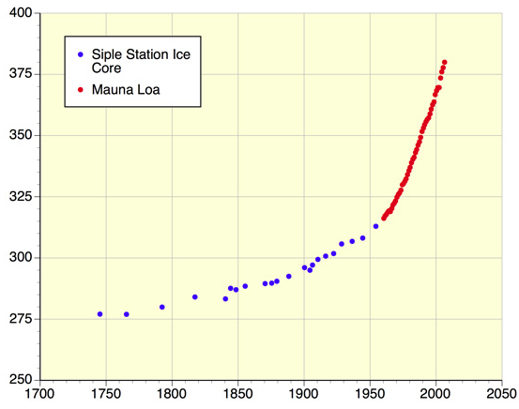
Increasing Atmospheric CO₂
CO₂ Results from Burning Fossil Fuels, Cement Production, and Deforestation
CO₂, ppm
http://www.eoearth.org/article/Greenhouse_gas?topic=60586

Slide 13
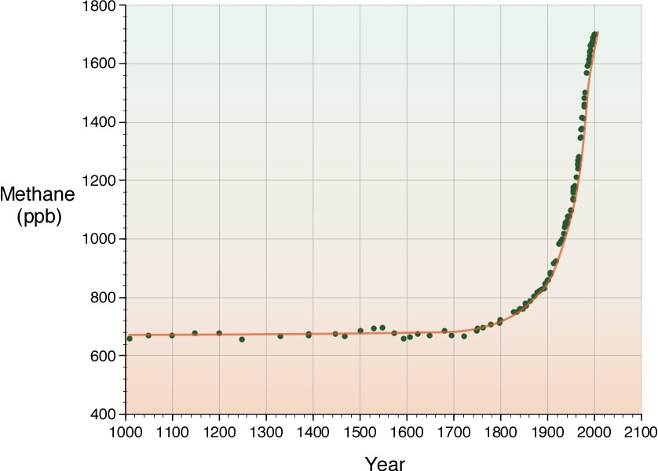
Increasing CH₄ in the Atmosphere
CH₄ Results from Agriculture, Fossil Fuel Extraction, Release From Methane Clathrates in the Tundra and Arctic
http://www.eoearth.org/files/145501_145600/145558/methane_eoe_atmosphere.jpg

Slide 14
If OLR Decreases
An Imbalance Results in Which Energy Out < Energy In
Atmosphere, Oceans, and Land Will Warm
Ice Will Melt
Oceans Will Rise

Slide 15
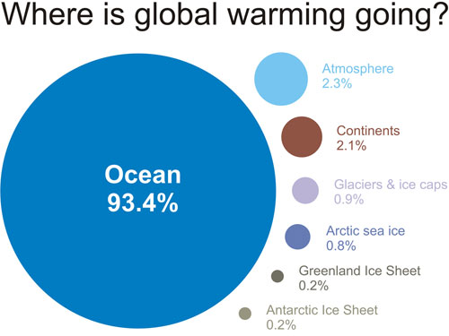
Where Does Excess Heat Go?
http://www.skepticalscience.com/graphics.php?g=12

Slide 16
Measuring Ocean Heat Content (OHC) Worldwide

Slide 17
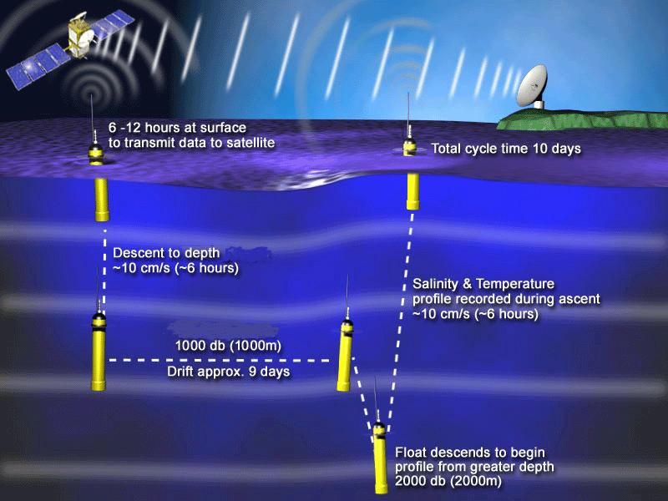
ARGO System for Ocean Temperatures
http://www.argo.ucsd.edu/operation_park_profile.jpg

Slide 18
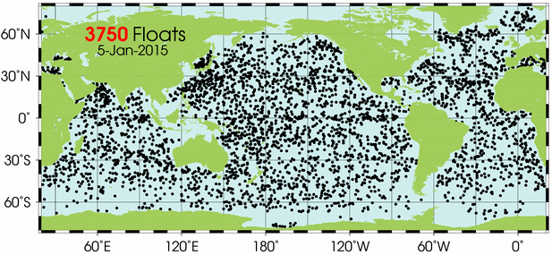
Distribution of ARGO Floats

Slide 19
OHC 10²² J

Slide 20
Measuring the Temperature of the Atmosphere Surface Temperatures Tropospheric Temperatures

Slide 21
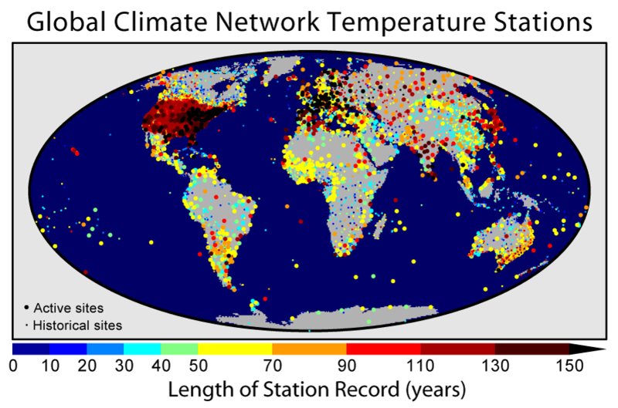
Measuring a Global Surface Temperature

Slide 23
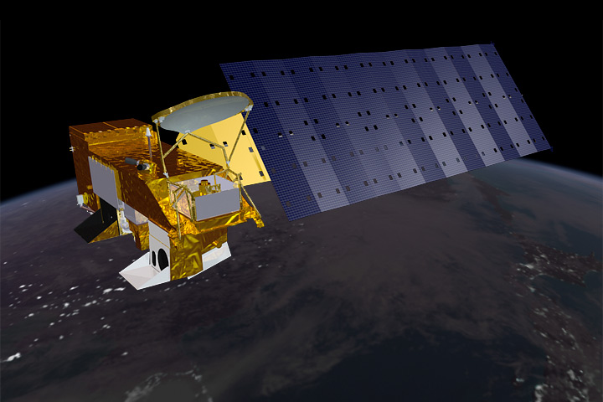
NASA AQUA Satellite – Advanced Microwave Sounding Unit (AMSU)
Used for Tropospheric Temperatures and for Sea Ice Extent

Slide 24
Tropospheric Temperatures Compared with Surface Temperatures
ΔT ̊C
http://data.giss.nasa.gov/gistemp/tabledata_v3/GLB.Ts+dSST.txt
http://vortex.nsstc.uah.edu/data/msu/t2lt/uahncdc_lt_5.6.txt

Slide 25
Measuring the Melting of Ice Sea Ice (Floating) Land Ice (Ice Sheets/Glaciers)

Slide 26
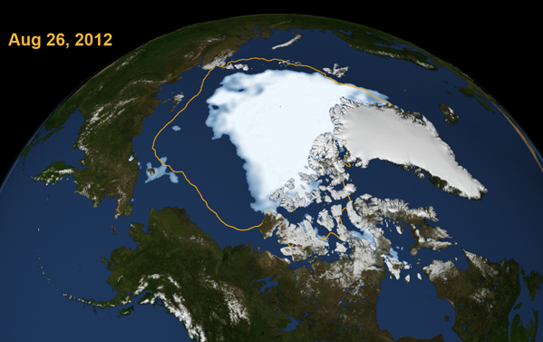
Melting of Arctic Sea Ice
Sea Ice
Land Ice

Slide 27
Arctic Sea Ice Extent

Slide 28
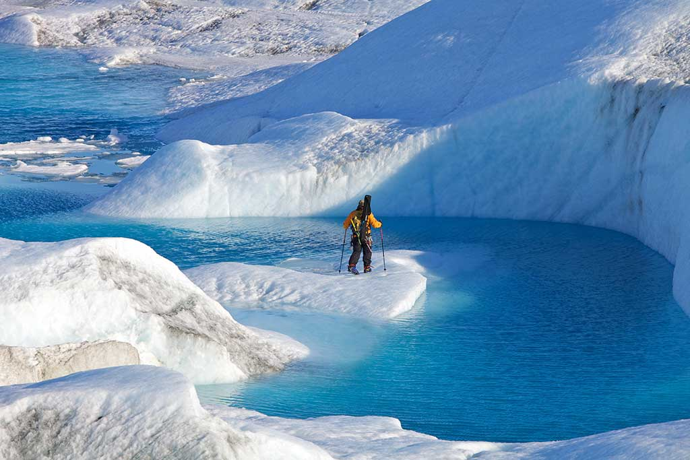
Melting of Land Ice
Greenland

Slide 29
GRACE Mission
http://www.nasa.gov/centers/jpl/images/content/92163main_craft1-browse.jpg

Slide 30
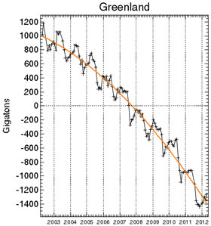
From GRACE (Gravity Recovery and Climate Experiment) Satellite Data

Slide 31
Measuring the Average Worldwide Sea Level

Slide 32
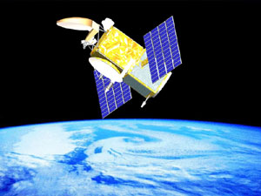
Jason II – Ocean Surface Topography Mission

Slide 33
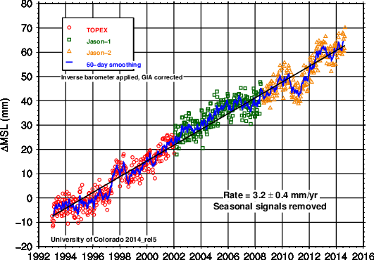
Sea Level from Satellite Radar Altimetry Data

Slide 34
So, What Does the Science Tell Us?
Atmospheric GHG are increasing and lowering the outgoing radiation (OLR)
All elements of Earth’s climate system are warming simultaneously
Observed warming is predicted and explained by increasing greenhouse gases in atmosphere

Slide 35
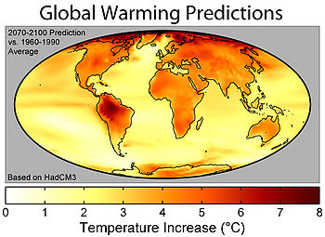

Slide 36
Possible Impacts
Disruption of Agriculture
Spread of Invasive Species/Disease
Severe Weather Events
Rising Seal Level – Costal Cities
Forest Fires
Ocean Acidification – Coral & Food Chain
Thawing of Tundra – Methane
Altering Climate Circulation Systems

Slide 37
Download This PowerPoint Presentation at: https://app.box.com/s/aofz4bavj0kho118onxg

